Slide 1


BANGALORE INSTITUTE OF TECHNOLOGY​ Department of Information Science & Engineering
PRESENTATION ON
"Analysis of Threat Intelligence-based Network Attack using Machine Learning”
Submitted in the partial fulfillment of the requirements for the award of the degree of
Master of Technology
in
COMPUTER NETWORK ENGINEERING
Presented by​
Ankita V Shet
1BI20SCN01​
​
Under the guidance of
Dr. Vani V​
Assistant Professor​
Dept. of ISE ​
​

Slide 2
Contents
Abstract
Cyber threats result in compromising the confidential information of a particular person or the organization. Hackers may leak necessary information to the unknown which may be hazardous. Cyber-attacks are not only limited to bigger organizations but also individuals. So, the hacker can target anyone for the information. The tendency of large-scale deployment of essential corporate applications in cloud centers has risen dramatically as cloud computing has progressed.
To solve this problem a new concept called Threat Intelligence was introduced by the research developers. Due to its capacity to evaluate threat intelligence data from various online assaults, threat intelligence will become an essential tool for resolving sophisticated network attacks, real-time threat time indications, and assault monitoring. This project's major objective is to employ various machine learning techniques to examine the threat intelligence datasets in predicting network attacks coming either from a corporate network or from a specific cluster.

Slide 3
Introduction
The network has become the main tool or weapon equipment for some malicious organizations to do evil, and the types of network threats are more complex and changeable.
Threat Intelligence is a subset of intelligence focused on information security.
Data Modeling
Model Validation
Data Sets
Results
Figure 1: Overview of the proposed model

Slide 4
Cont..
Security intelligence has become a lightweight important means to solve complex network attacks, threat early warning and security traceability.
Therefore, it is very important to reasonably use threat intelligence, share security intelligence information in real time, and establish a set of border real-time warning and defense system driven by security intelligence.
The main objective is to not to identify which algorithm is best, but to review the main dataset publicly available used to train and test security solutions that employ classification/regression algorithm. Hence KDD datasets were taken into considerations.
Training on infrastructure specific datasets is more efficient from the security point of view than training an old attack signatures.

Slide 5
Contents
Literature Survey
Sl. No | TITLE | AUTHOR | YEAR OF PUBLICATION | LIMITATIONS
1 | Cyber Threat Intelligence Model: An Evaluation of Taxonomies, Sharing Standards, and Ontologies within Cyber Threat Intelligence | Vasileios Mavroeidis, Siri Bromander | Feb 2021 | Hurdles to achieve include a lack of dedicated ontological cyber threat intelligence efforts that can account for the strategic, operational, and tactical levels; ambiguity in defined concepts that prevents ontology integration and adoption
2 | Detecting Vulnerabilities in Critical Infrastructures by Classifying Exposed Industrial Control Systems Using Deep Learning | Pablo Blanco-Medina , Eduardo Fidalgo , Enrique Alegre , Roberto A. Vasco-Carofilis , Francisco Jañez-Martino and Victor Fidalgo Villar | 2018 | Further improving the proposed solution, increasing our training images, and adding new layers on top of the given architectures based on VGG16 results.

Slide 6
Contents
Literature Survey
Sl. No | TITLE | AUTHOR | YEAR OF PUBLICATION | LIMITATIONS
3 | A Cloud Computing Based Network Monitoring and Threat Detection System for Critical Infrastructures | ZhijiangChen, GuobinXu, VivekMahalingam, LinqiangGe, JamesNguyen, WeiYu∗, ChaoLu | 2 November 2015 | The researchers did not put the computational cost into consideration in the choice of which machine learning technique to use for spam mail filtering. Their main focus is performance in terms of classification accuracy.
4 | Analysis of adversary activities using cloud-based web services to enhance cyber threat intelligence | Hamad Al-Mohannadi1 · Irfan Awan1 · Jassim Al Hamar | 2020 | Attacker tried to get access to root but failed. In a UNIX-based system, getting access to the root gives attackers full control to the system. Since the authentication was not confirmed, the attacker could not get the access.

Slide 7
Cont..
Disadvantages
Lack of precision in attack detection.
It is difficult to control the access of network in real time.
Less security and privacy.
Advantage of Proposed system
Predicts the precision about insider and outsider attacks.
Improves reliable data access control and can handle huge number of data.

Slide 8
Contents
Problem Identification
With the development of the Internet and the application of information technology, the general trend is opener. Important data and important business applications will face more serious security threats.
The network has become the main tool or weapon equipment for some malicious organizations to do evil, and the types of network threats are more complex and changeable.
The existing security solutions are difficult to cope with the high level, continuous, group and weaponization threats.
However, important industries and key information infrastructure security network units mainly support apt detection and defense equipment with high application threshold and general landing effect.

Slide 9
Objectives
To analyze the security given from the insider and outsider attacks. Applications employ machine learning techniques to recognize and respond to assaults. Larger data sets of security events can be analyzed to find correlations in harmful activity and help with this. When similar actions are found, ML makes it if the trained ML model can intelligently handle them.
It is crucial to investigate and use advanced techniques for the detection and reporting of such assaults because there are more and more cyberattacks targeting crucial networked resources that cannot be detected by conventional monitoring tools. Hence the main objective is to improve the accuracy of attack detection.

Slide 10
Proposed System
As the previous sections explain the existing problems, the proposed system is being developed for analyzing the dataset using a Graphical User Interface. It mainly analyses the insider or outsider attacks to enhance the accuracy of attack detection. It improves reliable data access control and can handle huge amounts of data.
Threat Intelligence is the process of identifying the threats and analyzing them in other words this feature informs the user about the current threats and the threats which are about to happen in the current scenario of the organization.
Hence several machine learning algorithms are employed just to check the efficiency of the network attack blocking method. Threat intelligence feeds can help with this approach by detecting real-time indications of the breach and advising preventative measures.
The results are examined utilizing network attack data sets, demonstrating that it is one of the best competitor data sets for threat intelligence analysis and testing.

Slide 11
Requirement Analysis
Software Requirements
Anaconda
Python Programming language
Software Packages
Keras
TensorFlow
Software And Hardware Requirements
Operating system used is the Windows 8/10/11.
Processor – Ryzen 7@ 3.20 GHz
RAM – 8GB and above
Hard disk –20 GB is required to store the data set obtained.

Slide 12
Contents
Threat Intelligence
Threat intelligence, or cyber threat intelligence, is information an organization uses to understand the threats that have, will, or are currently targeting the organization. This info is used to prepare, prevent, and identify cyber threats looking to take advantage of valuable resources.
Ensure to stay up to date with the often overwhelming volume of threats, including methods, vulnerabilities, targets and bad actors.
Help one to become more proactive about future cybersecurity threats.
Keep leaders, stakeholders and users informed about the latest threats and repercussions they could have on the business.

Slide 13
Data Collection
Planning, Direction and Comments
Data Processing and System Exploitation
Solution Dissemination
Threat Analysis and Solution Creation
Figure 2: Life cycle of Threat intelligence

Slide 14
System Workflow
The System Workflow description is briefly explained where the first step in creating a predictive model is to create a dataset. The dataset can be thought of as practically being an MN matrix, where M stands for the columns (features) and N for the rows (samples). One might divide columns into X and Y for example. The method of picking features, whether automatic mode or not, depends on which components are most important to the target variable or desired outcome.
Algorithms' performance was accurately depicted after being evaluated against the aforementioned criteria. Some experts were just concerned with the algorithm's correctness, some were worried about how well the system performed when tested against every matrix parameter.

Slide 15
Initial Dataset
TF-IDF Algorithm
Data Cleaning
Event Vector
Data Segregation
Data Splitting
Training Data
80%
20%
Test Data
SVM
Random Forest
Naïve Bayes
Decision Tree
LSTM
Training Dataset
KNN
CNN
Trained Model
Evaluate Model Performance
Figure 3: System Workflow of the proposed system

Slide 16
Sequence Diagram
User
System
Load Dataset
Read
Preprocess
Train
Detect malware
Graph
Performance analysis
Figure 4: Sequence Diagram

Slide 17
Implementation
Dataset description
The dataset is collected from the kaggle.com
The dataset contains day wise packet transaction detail attributes like Destination Port, Flow Duration, Total Fwd Packets, Total Backward Packets, Total Length of Fwd Packets,Total Length of Bwd Packets, Fwd Packet Length Max, Fwd Packet Length Min, Fwd Packet Length Mean, Fwd Packet, Length Std, Bwd Packet Length Max, Bwd Packet Length Min, Bwd Packet Length Mean Bwd, total 76 attributes and 1 label class.

Slide 18
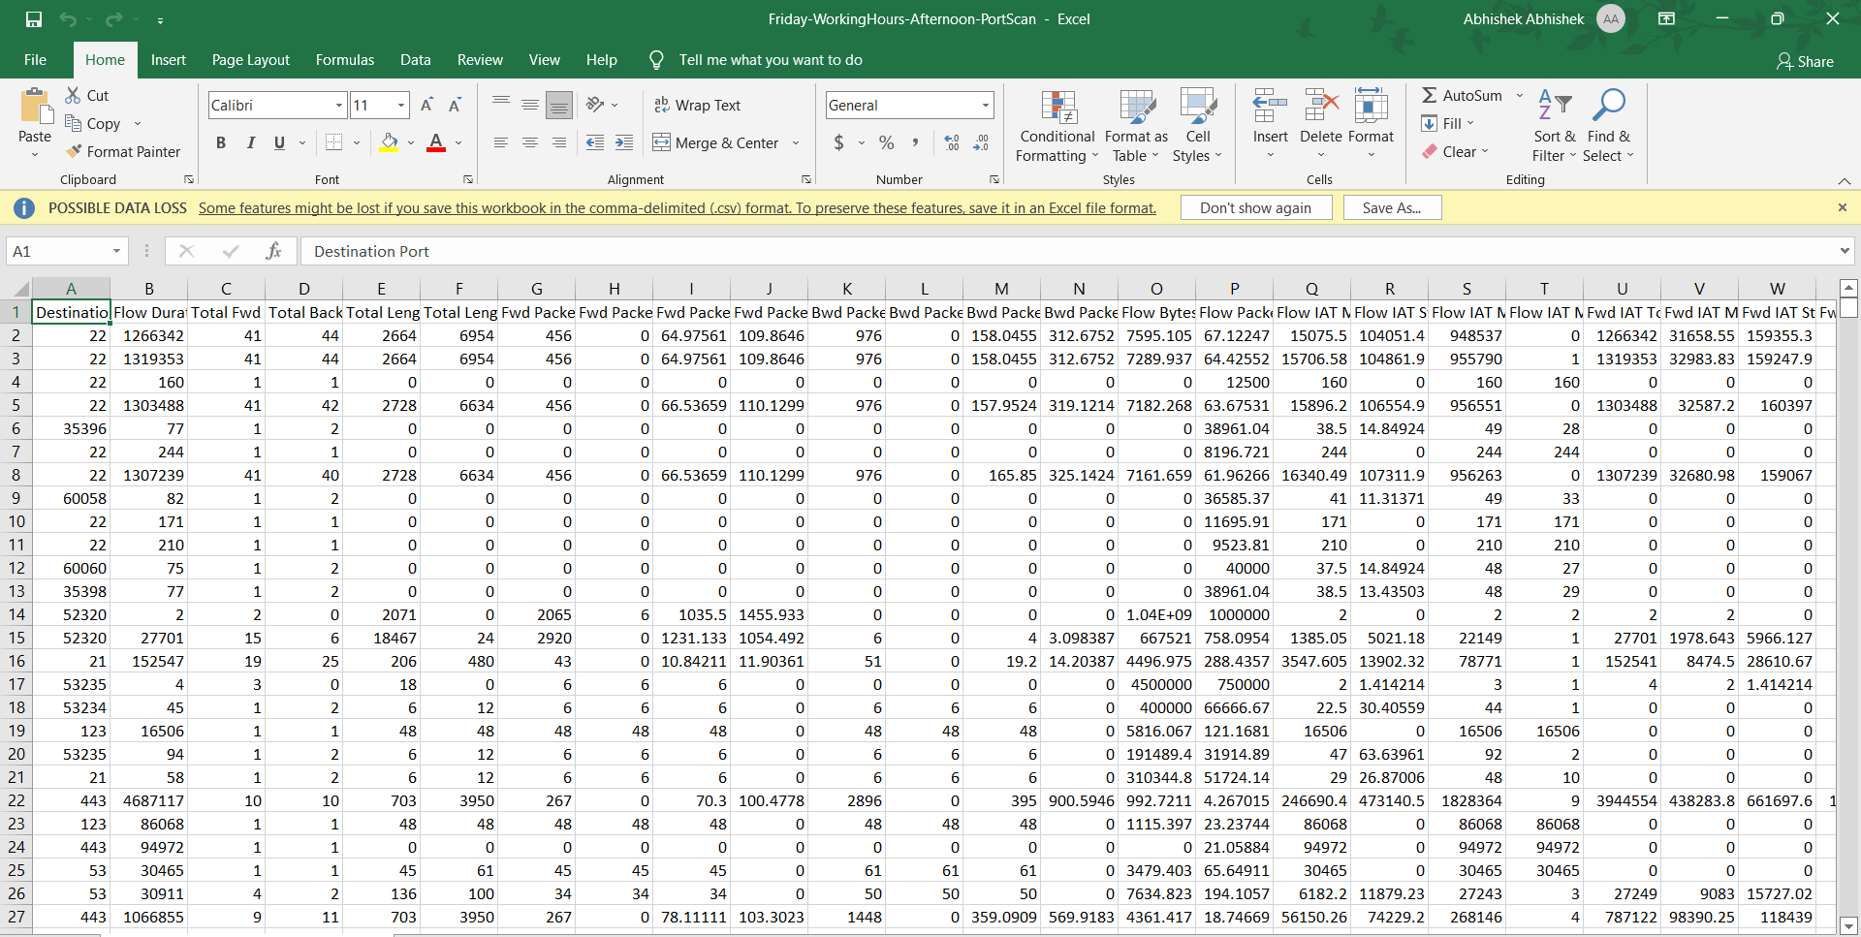
Cont..
Figure 5: Snapshot of Dataset

Slide 19
Cont..
Destination Port: Destination of the packets in the network.
Flow Duration: Time taken by the packet to reach from source to destination
Total Fwd Packets: Total number of packets that flowed from source to destination
Total Backward Packets: Total number of packets that flowed from destination to source
Total Length of Fwd Packets: Total length of the Forwarded packet.
Total Length of Bwd Packets: Total length of the backward packets
Fwd Packet Length Max: Max length of the forward packet
Fwd Packet Length Min: Min length of the forward packets
Fwd Packet Length Mean: Mean of the forward packets which specifies the mean value
Fwd Packet, Length Std, Bwd Packet Length Max, Bwd Packet Length Min, Bwd Packet Length Mean Bwd, total 76 attributes and 1 label class.

Slide 20
Preprocessing
Getting the dataset.
Importing libraries.
Importing datasets.
Finding Missing Data.
Removing the duplicate data.
Fixing Structural errors.

Slide 21
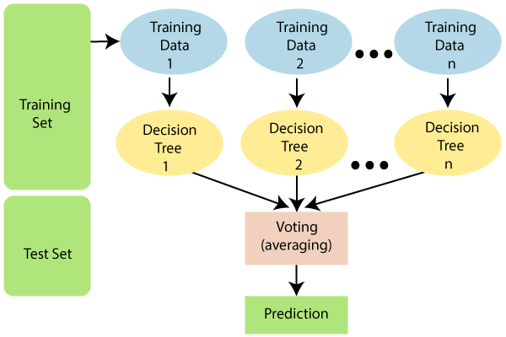
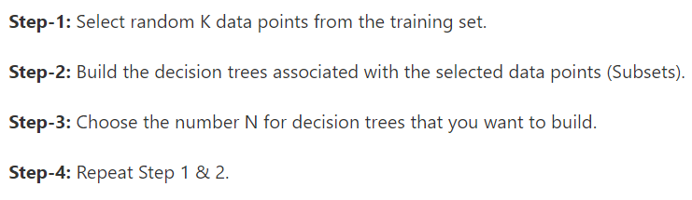
Algorithms used
Random forests are ensemble learning methods that are used for either classification or regression purposes. Random forests are composed of several decision trees that are combined together to make a unanimous decision or classification. Random forest are better than just regular decision trees because they do not cause overfitting of the data.
Algorithm 1
Figure 6: Random forest tree

Slide 22
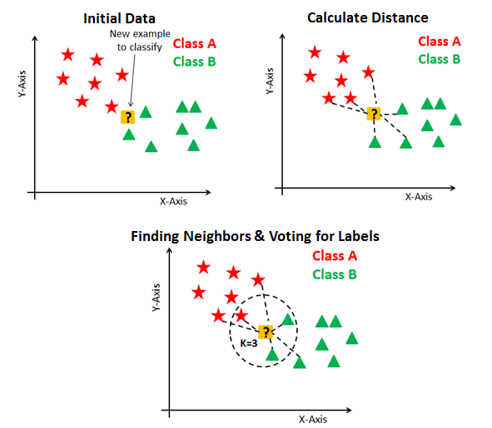
Cont..
KNN(k-nearest neighbor) is a lazy learning, non-parametric algorithm. It uses data with several classes to predict the classification of the new sample point. KNN is non-parametric since it doesn’t make any assumptions on the data being studied, i.e., the model is distributed from the data.
Algorithm 2
Step 1 − For implementing any algorithm, we need dataset. So during the first step of KNN is to load the training as well as test data.
Step 2 − Next, we need to choose the value of K i.e. the nearest data points. K can be any integer.
Step 3 − Calculate the distance between test data and each row of training data with the help of any of the method namely: Euclidean, Manhattan or Hamming distance. The most commonly used method to calculate distance is Euclidean.
Step 4 − End
Figure 7: KNN Algorithm

Slide 23
Cont..
Naive Bayes classifiers are a collection of classification algorithms based on Bayes’ Theorem. It is not a single algorithm but a family of algorithms where all of them share a common principle, i.e. every pair of features being classified is independent of each other.
Algorithm 3
Convert the given dataset into frequency tables.
Generate Likelihood table by finding the probabilities of given features.
Now, use Bayes theorem to calculate the posterior probability.
Figure 8: Naïve Bayes Algorithm

Slide 24
Cont..
Decision tree are simple to implement and equally easy to interpret.
Decision Trees are a non-parametric supervised learning method used for both classification and regression tasks. The goal is to create a model that predicts the value of a target variable by learning simple decision rules inferred from the data features.
Algorithm 3
Step-1: Begin the tree with the root node, says S, which contains the complete dataset.
Step-2: Find the best attribute in the dataset using Attribute Selection Measure (ASM).
Step-3: Divide the S into subsets that contains possible values for the best attributes.
Step-4: Generate the decision tree node, which contains the best attribute.
Figure 9: Decision Tree Algorithm

Slide 25
Cont..
SVM(Support Vector Machine) is a supervised machine learning algorithm used for both classification and regression. The objective of SVM algorithm is to find a hyperplane in an N-dimensional space that distinctly classifies the data points. The dimension of the hyperplane depends upon the number of features. The objective of the support vector machine algorithm is to find a hyperplane in an N-dimensional space (N — the number of features) that distinctly classifies the data points.
Hyperplanes are decision boundaries that help classify the data points. Data points falling on either side of the hyperplane can be attributed to different classes.
Figure 10: SVM Algorithm

Slide 26
Cont..
Neural Networks also known as Artificial Neural Networks (ANNs) or Simulated Neural Networks (SNNs), are a subset of machine learning and are at the heart of deep learning algorithms. Their name and structure are inspired by the human brain, mimicking the way that biological neurons signal to one another.
Figure 11: Neural Network

Slide 27
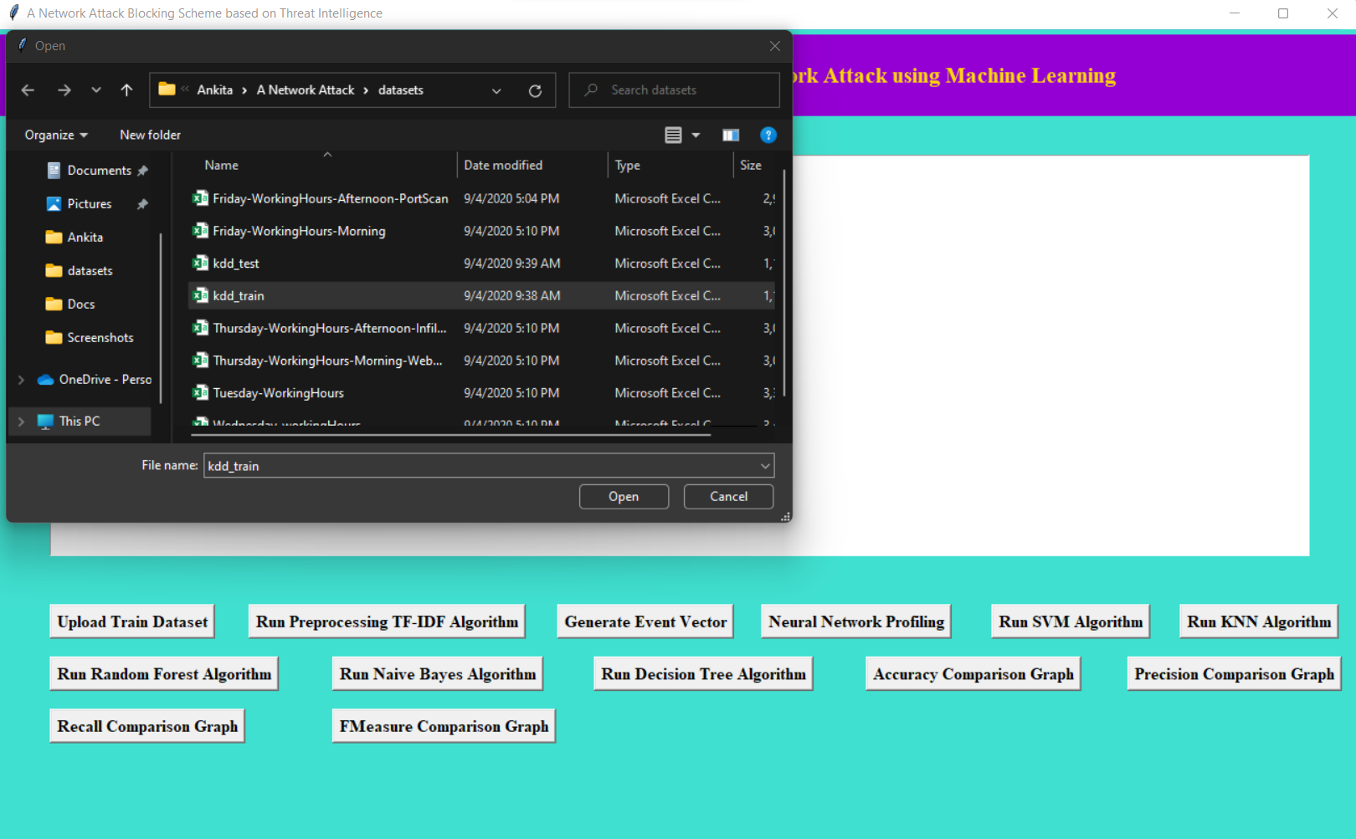
Results and Analysis
Figure 12: Uploading the dataset

Slide 28
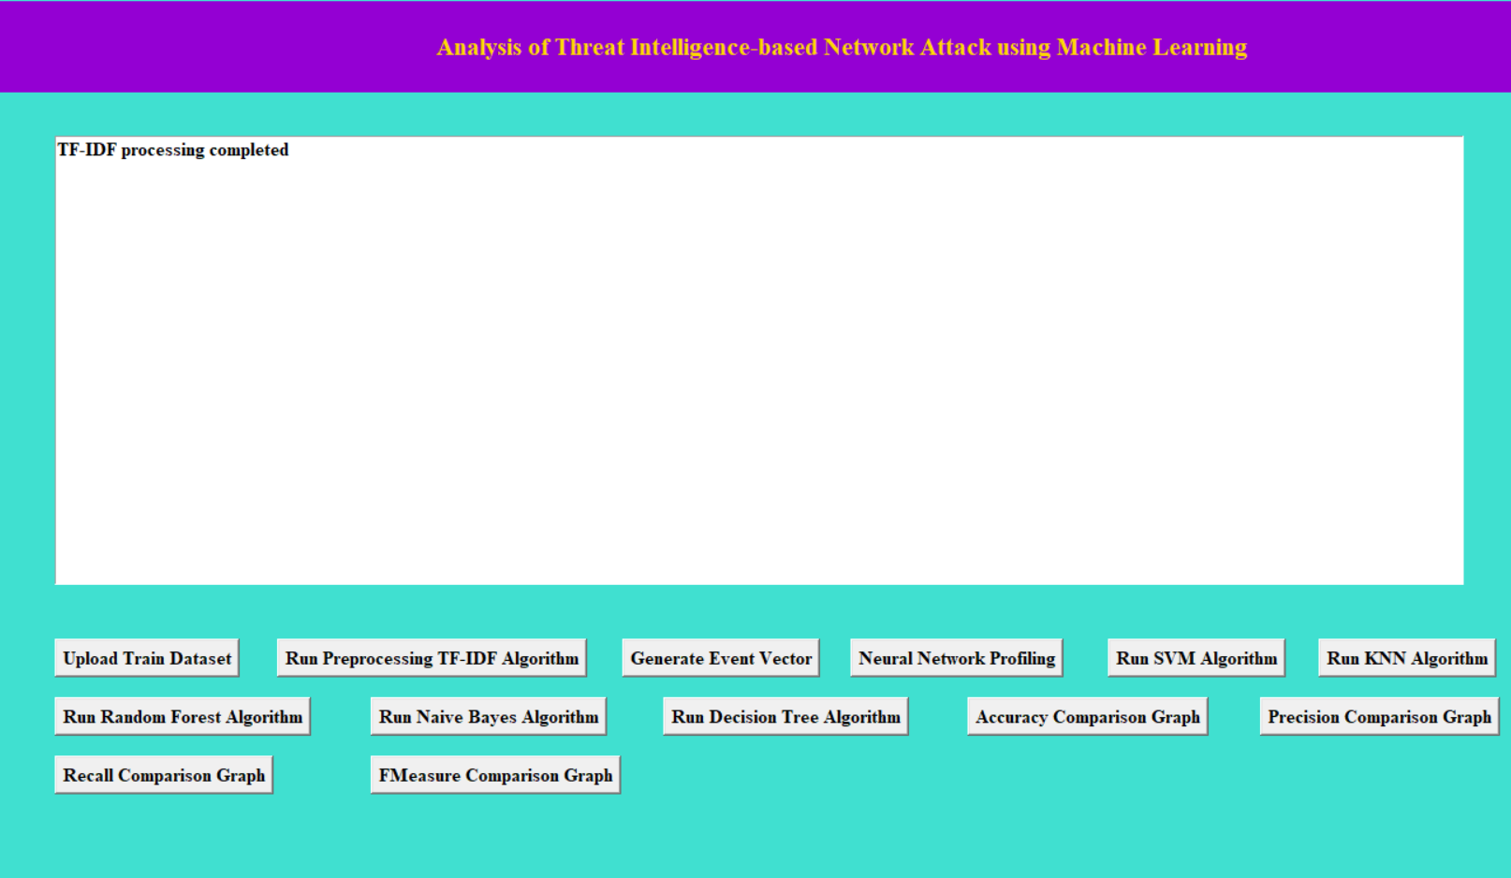
Figure 13: Running the TF-IDF Algorithm

Slide 29
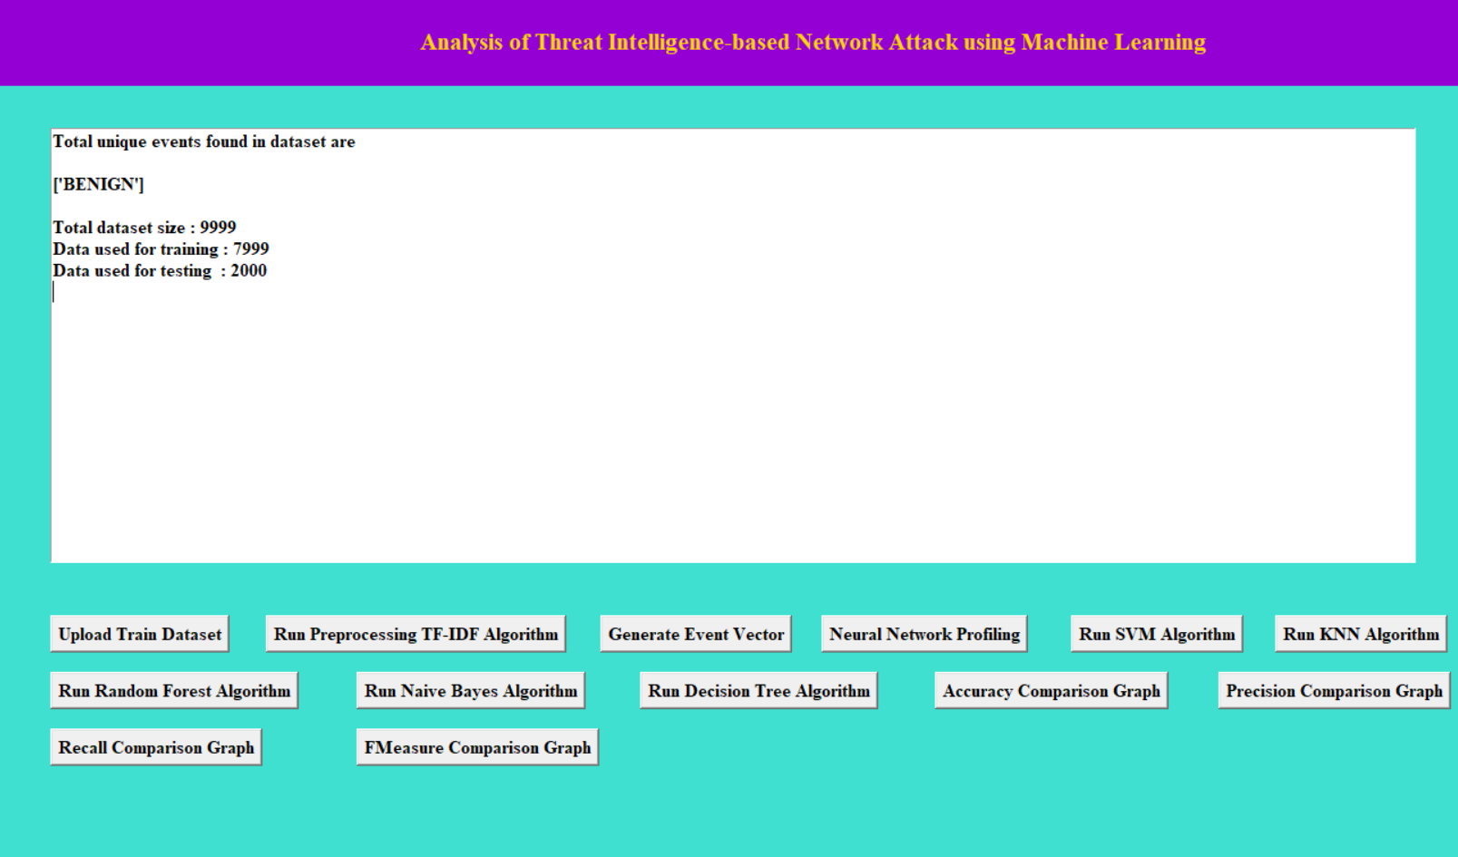
Figure 14: Generating the Event Vector

Slide 30
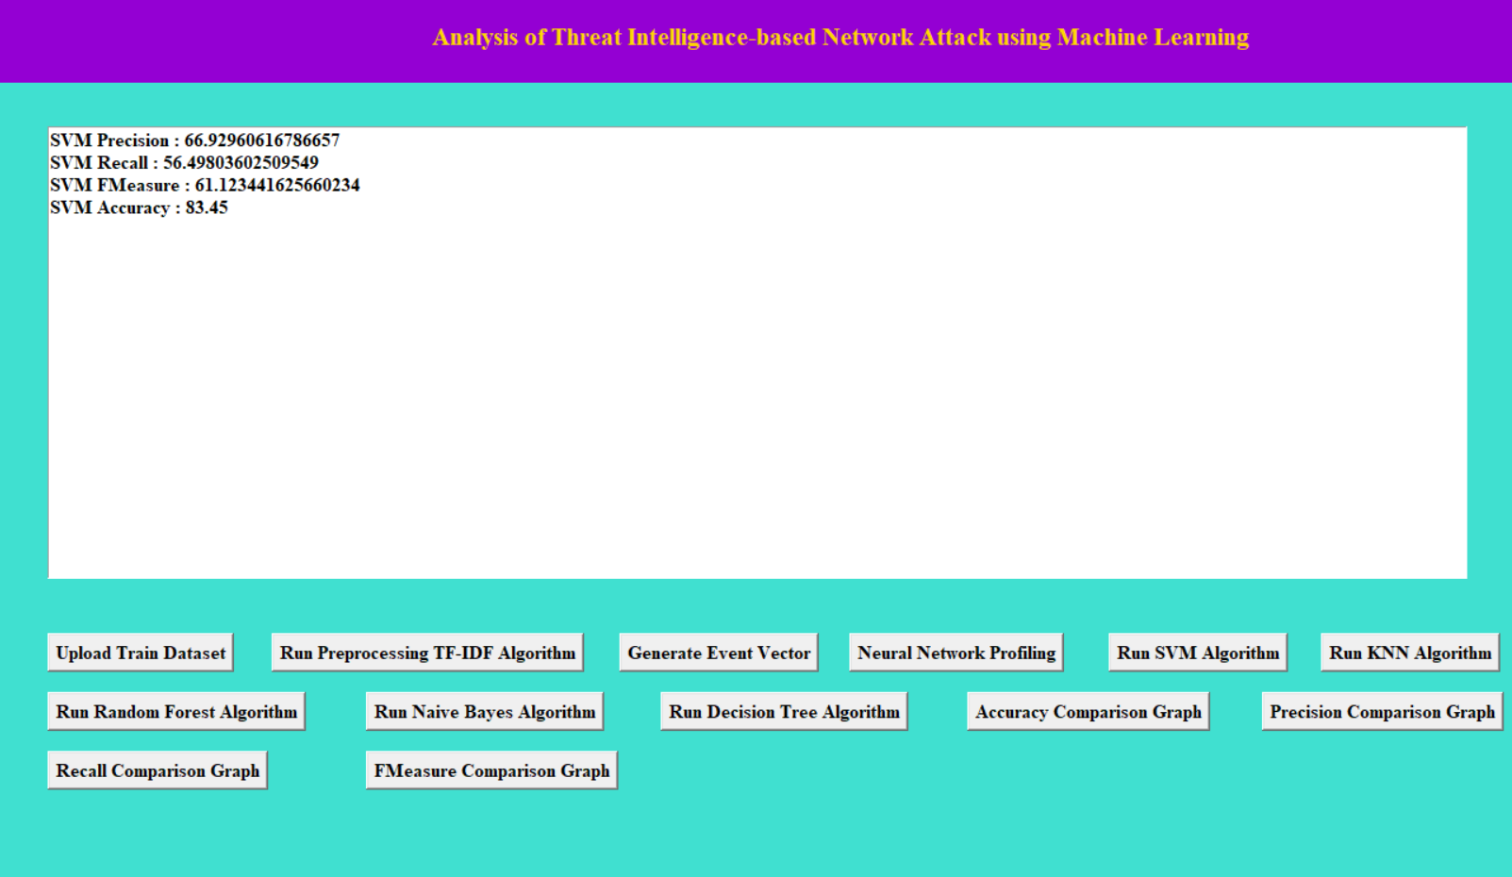
Figure 15: Support Vector Machine Algorithm Prediction Results

Slide 31
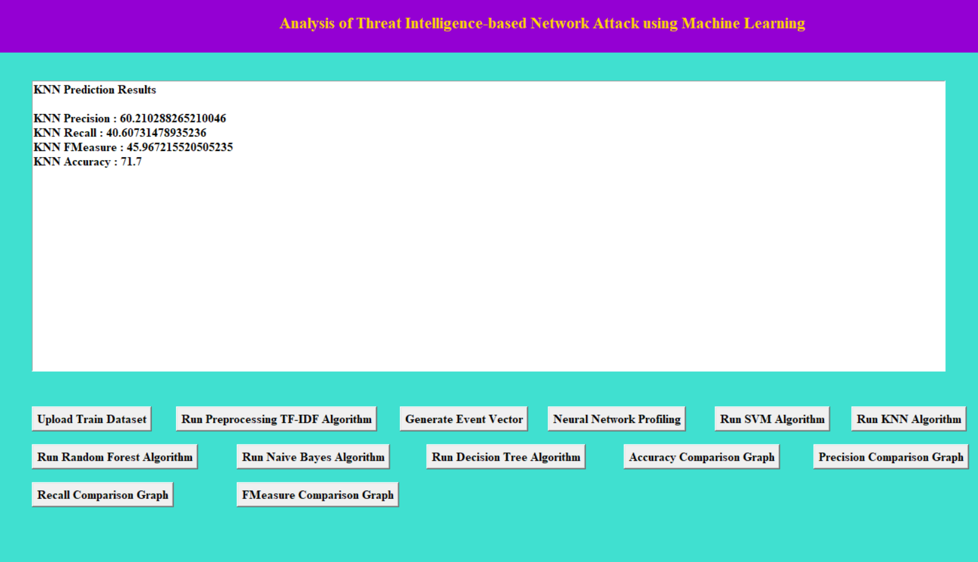
Figure 16: KNN Algorithm Prediction Results

Slide 32
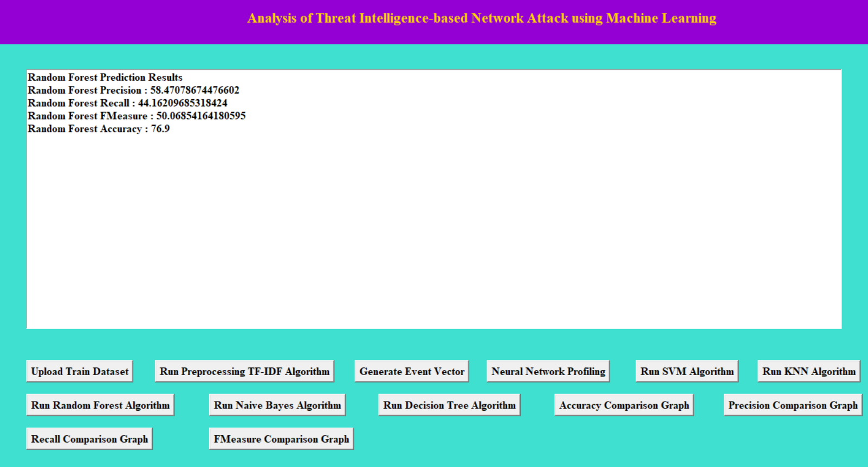
Figure 17: Random Forest Algorithm Prediction Results

Slide 33
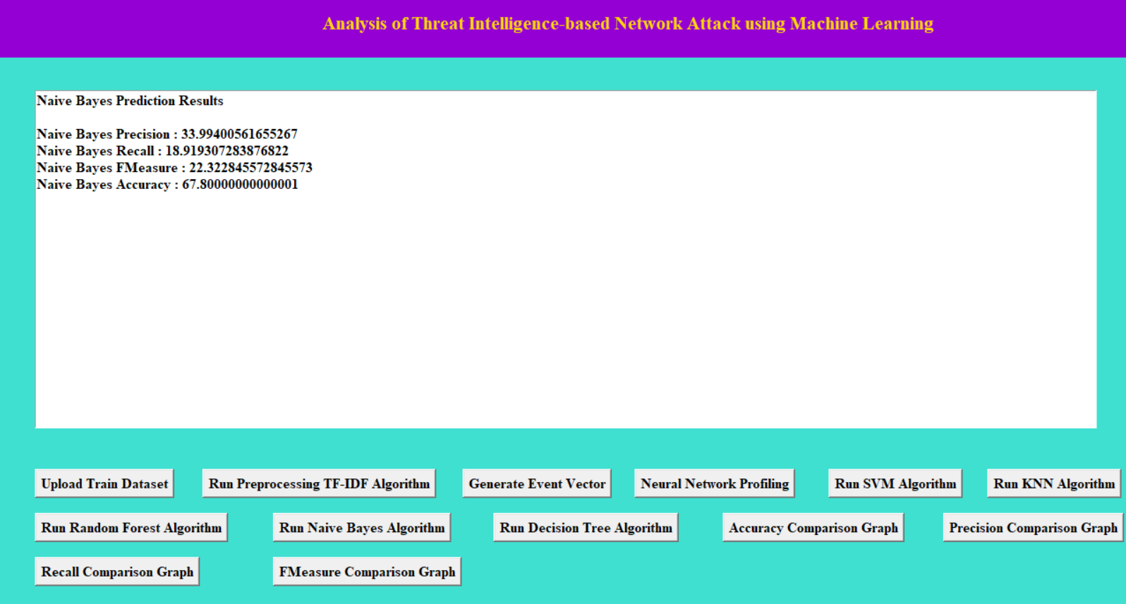
Figure 18: Naïve Bayes Algorithm Prediction Results

Slide 34
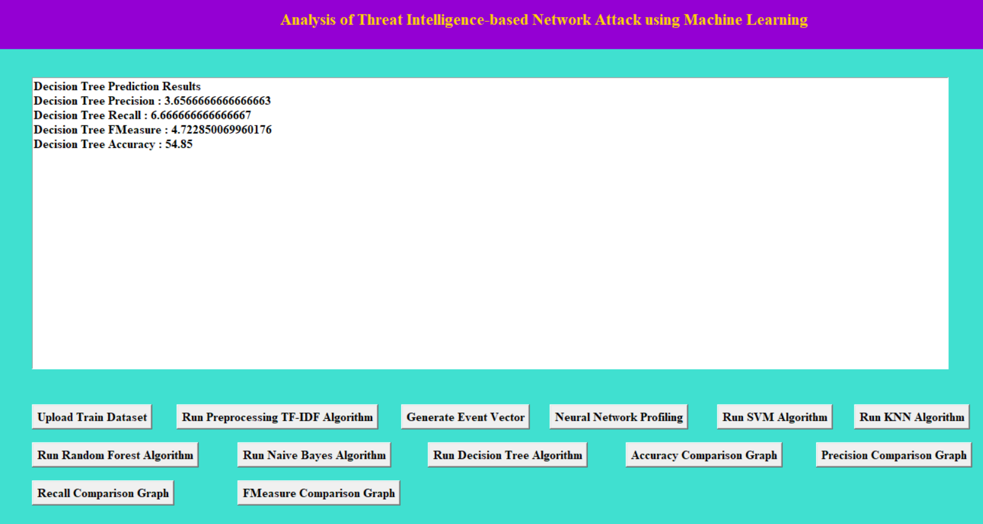
Figure 19: Decision Tree Algorithm Prediction Results

Slide 35
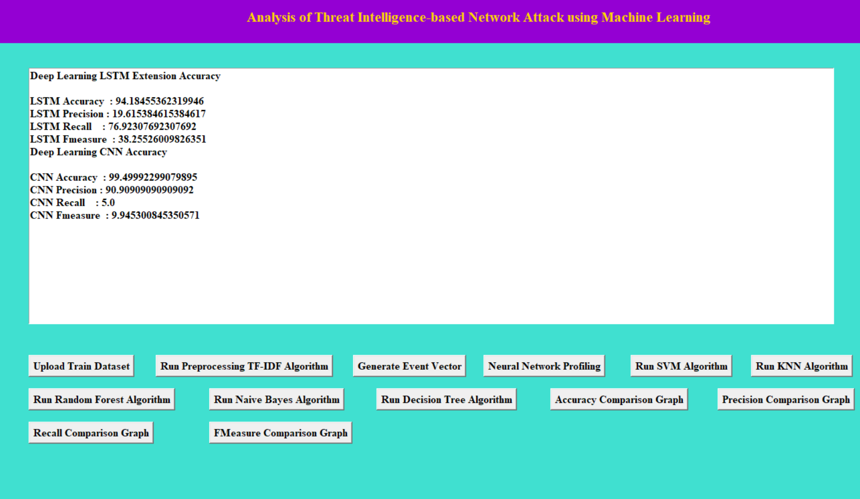
Figure 20: Neural Network Profiling Prediction Results

Slide 36
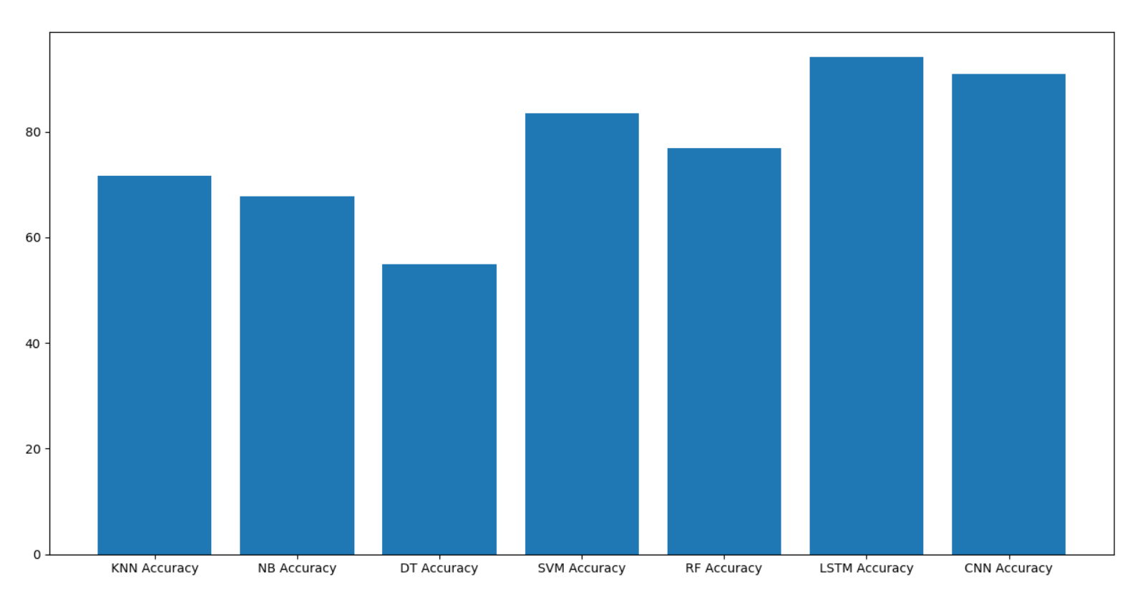
99.4%
94.1%
83.45%
76.9%
71.7%
67.8%
54.48%
Figure 21: Comparison Graph of all Algorithm

Slide 37
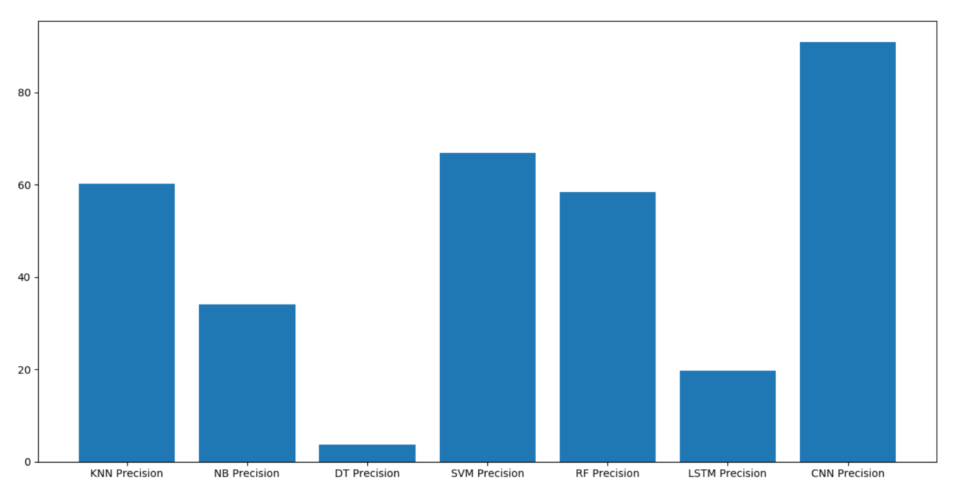
90.90%
66.92%
60.21%
58.74%
33.99%
19.61%
3.65%
Figure 22: Precision Graph of all Algorithm

Slide 38
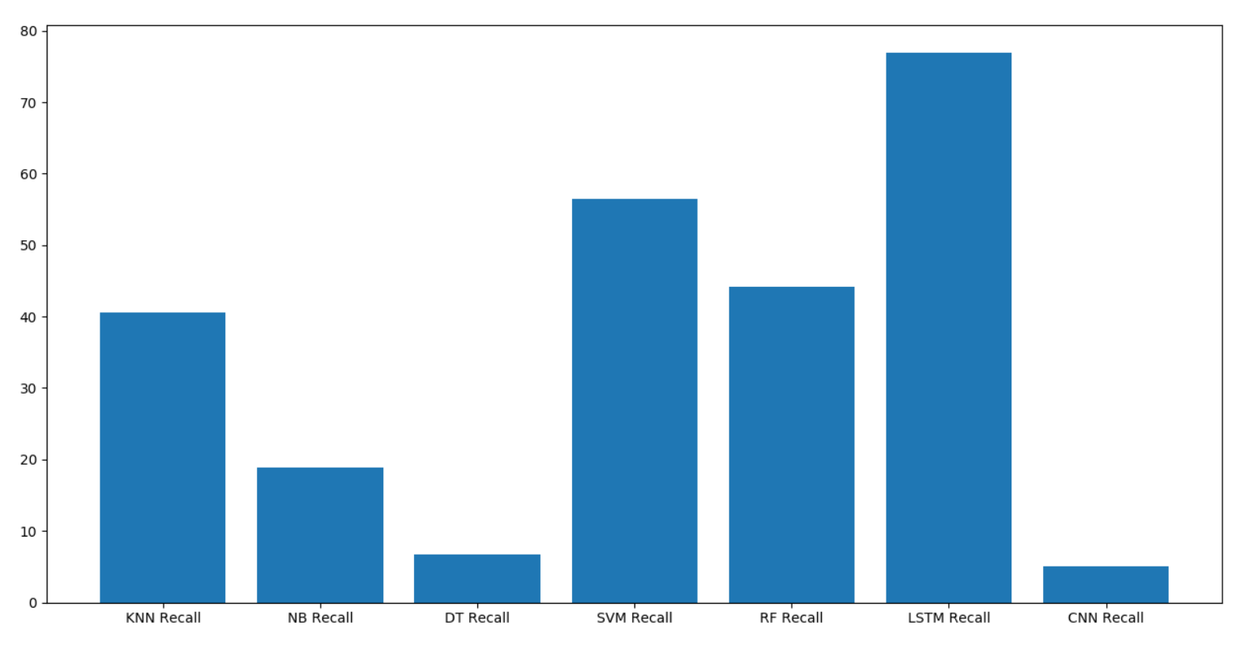
76.92%
56.49%
44.16%
40.607%
18.91%
6.66%
5.0%
Figure 23: Recall Graph of all Algorithm

Slide 39
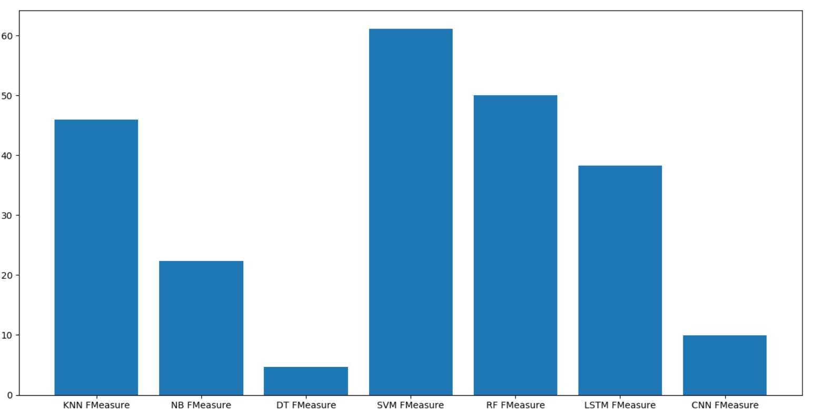
61.123%
50.068%
45.96%
38.25%
22.32%
9.94%
4.722%
Figure 24: F1 measure Graph of all Algorithm

Slide 40
Conclusion
The results are examined utilizing network attack data sets, demonstrating that it is one of the best competitor data sets for threat intelligence analysis and testing. The TI model improves both the accuracy and the detection time.
After experimenting with various numbers of traits, it was discovered that 22 of the 76 attributes have a categorization accuracy of roughly 99 percent. And, of the 22 features, 11 are more important to total classification accuracy, while the remaining 9 are less important.
The classification accuracy is 99.4 percent when these 13 out of 22 features are used.

Slide 41
Future Work
Can reduce the number false positive rates so that the performance increases by this.
To develop a system model with a higher precision rate while using fewer characteristics to improve overall accuracy.
Datasets like NSL-KDD can be considered in future research.

Slide 42
Contents
References
[1] Mavroeidis, Vasileios, and Siri Bromander. "Cyber threat intelligence model: an evaluation of taxonomies, sharing standards, and ontologies within cyber threat intelligence." 2017 European Intelligence and Security Informatics Conference (EISIC). IEEE, 2017.
[2] Blanco-Medina, Pablo, et al. "Detecting vulnerabilities in critical infrastructures by classifying exposed industrial control systems using deep learning." Applied Sciences 11.1 (2021): 367.
[3] Chen, Zhijiang, et al. "A cloud computing based network monitoring and threat detection system for critical infrastructures." Big Data Research 3 (2016): 10-23.
[4] Al-Mohannadi, Hamad, Irfan Awan, and Jassim Al Hamar. "Analysis of adversary activities using cloud-based web services to enhance cyber threat intelligence." Service Oriented Computing and Applications 14.3 (2020): 175-187.

Slide 43
THANK YOU

